Slide 1
CSC 5930-9010: Computing for Data Science FIFA World Cup Data Analysis
Satya Manepalli

Slide 2
Exploratory Data Analysis
In statistics, exploratory data analysis (EDA) is an approach to analyzing data sets to summarize their main characteristics, often with visual methods. A statistical model can be used or not, but primarily EDA is for seeing what the data can tell us beyond the formal modeling or hypothesis testing task.

Slide 3
Data Set Description
The World Cups dataset show all information about all the World Cups in the history, while the World Cup Matches dataset shows all the results from the matches contested as part of the cups.
This dataset has 3 different CSV files
WorldCupMatches.csv
WorldCupPlayers.csv
WorldCups.csv

Slide 4
Columns Available
Year,
Date Time
Stage
Stadium
City
Home Team Name
Home Team Goals
Away Team Goals
Away Team Name
Win conditions
Attendance
Half-time Home Goals
Half-time Away Goals
Referee
Assistant 1
Assistant 2
RoundID
MatchID
Home Team Initials,
Away Team Initials

Slide 5
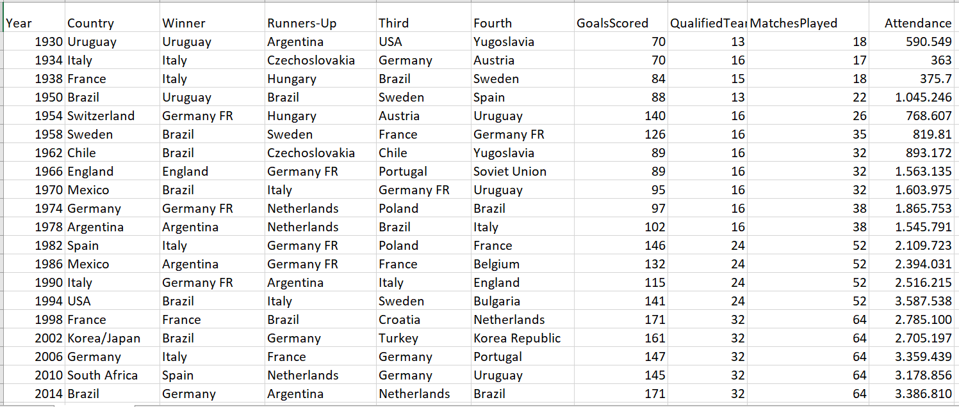

Slide 6
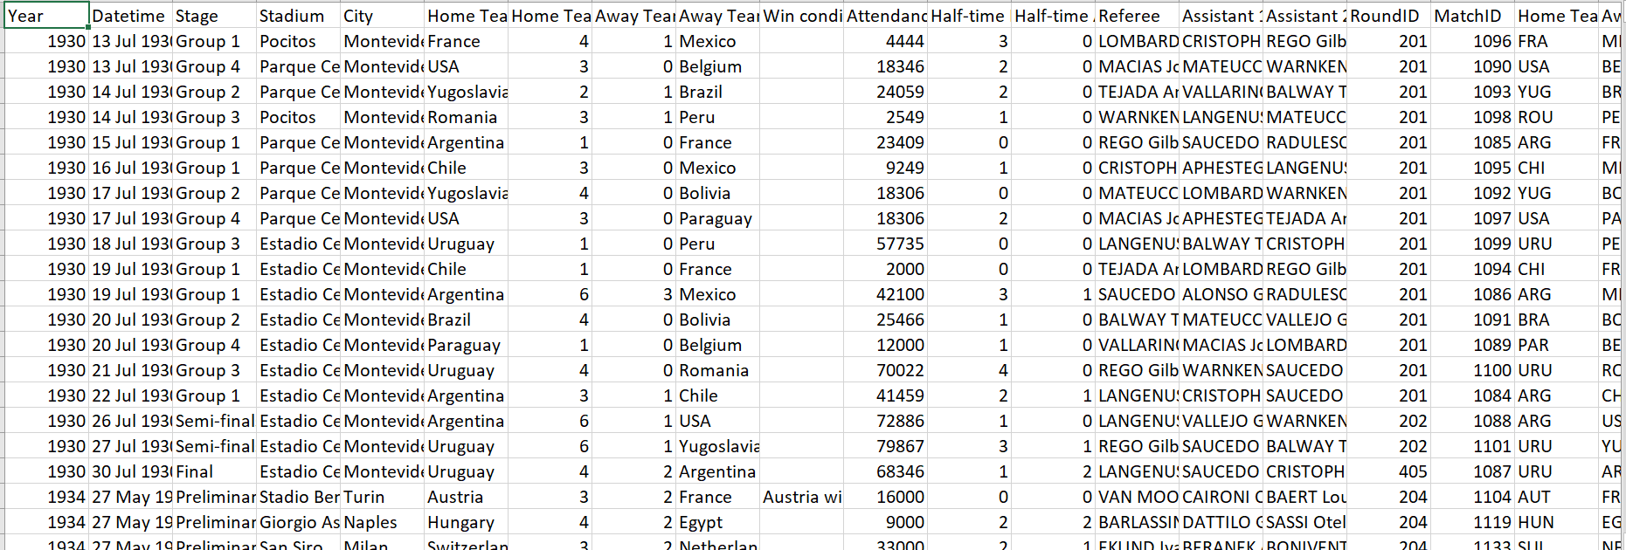

Slide 7
Libraries Used
import numpy as np
import pandas as pd
import matplotlib.pyplot as plt
import seaborn as sns
from PIL import Image
from IPython import get_ipython
from sklearn.svm import SVR
from sklearn import linear_model
from sklearn.neighbors import KNeighborsRegressor

Slide 8

Teams with the most world cup final victories
In the worldcup.csv column “Winner” is there.
finding the count of number of victories of each and every team by using value_counts() and finding the maximum value and returns the team respect to that value.

Slide 9
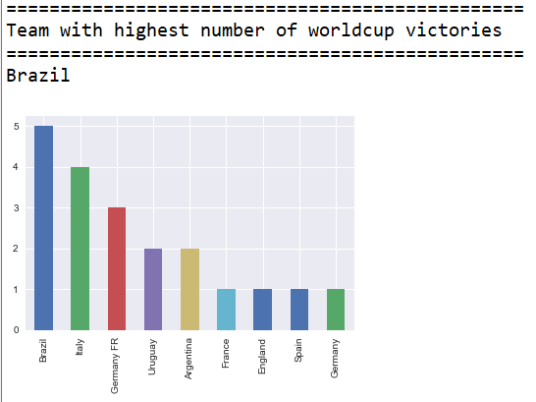

Slide 10
World cup final result for third and fourth place by the nation
By using the sort functions.. Finding the teams that stood in 3rd and 4th places every year and grouping them into two different data frames.
Then applying the value_counts() to find the count of each team in the particular place(3rd/4th)
Finding the maximum value of each place and team respect to that.

Slide 11
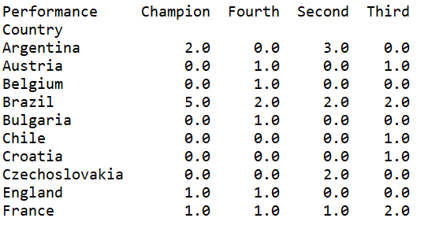
World cup final result for third and fourth place by the nation

Slide 12
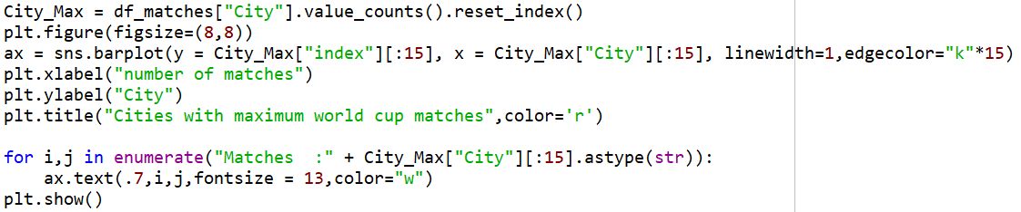
Cities that hosted the highest world cup matches
City_Matches_Count = df_matches["City"].value_counts().reset_index()
By using python data visualization library seaborn a plot is drawn with cities and number of times it hosted worldcup

Slide 13
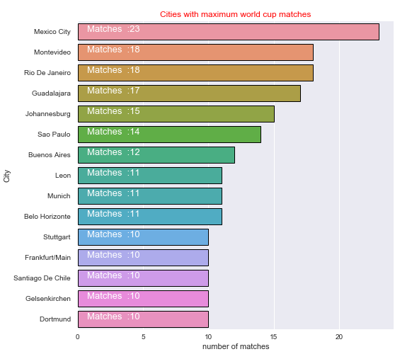
Cities that hosted the highest world cup matches

Slide 14
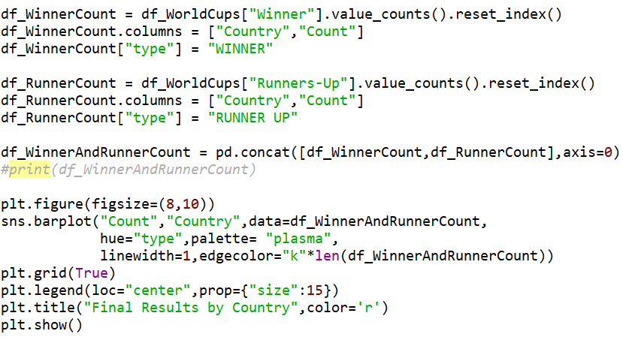
Final Results By Country

Slide 15
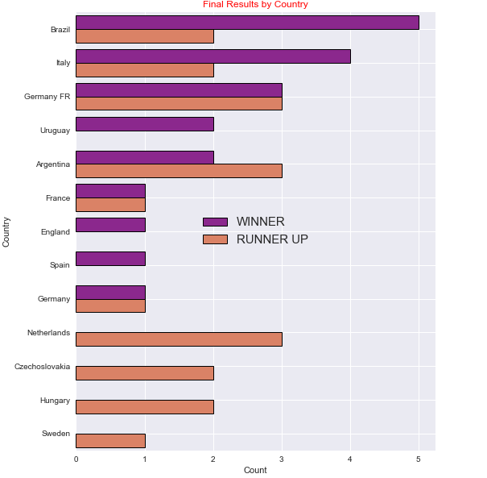
Final Results By Country
Notes:
By grouping to the cities and finding the mean of attendance

Slide 16
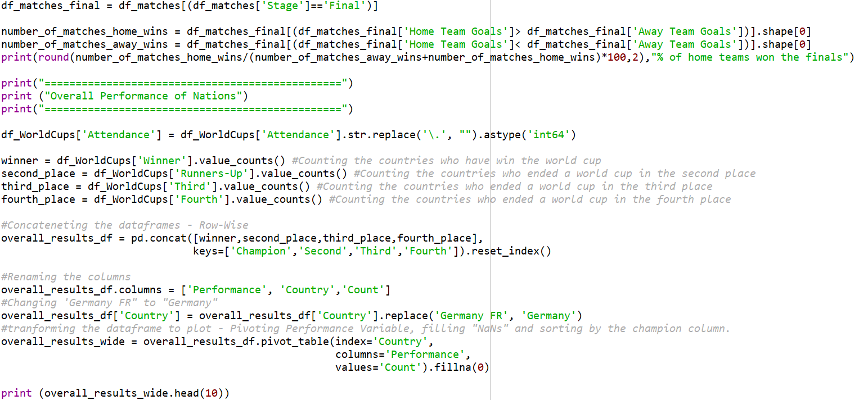
Overall Performance of The Nations

Slide 17
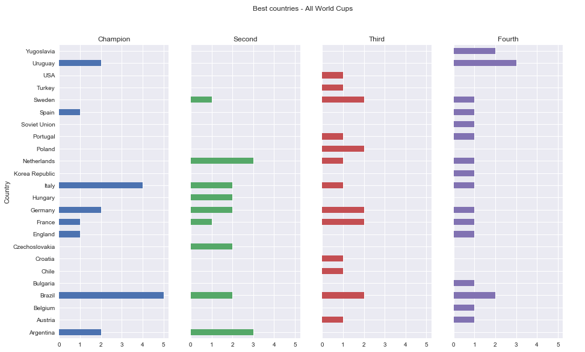

Slide 18
How Likely Home Team Wins

Slide 19
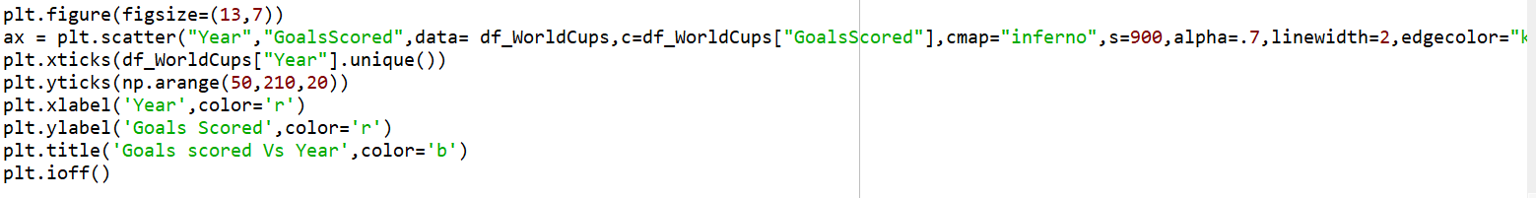
Goals Scored Vs Year

Slide 20
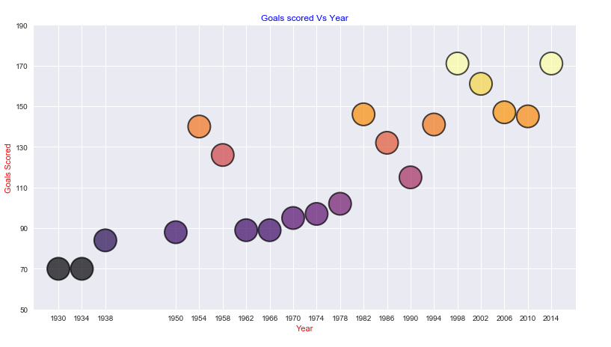

Slide 21
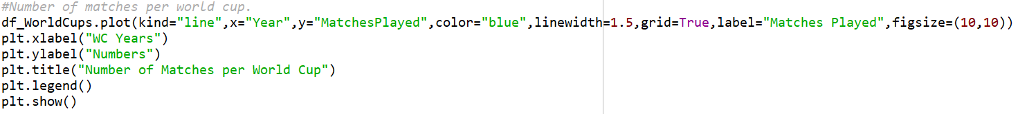
Number of Matches Per Year

Slide 22
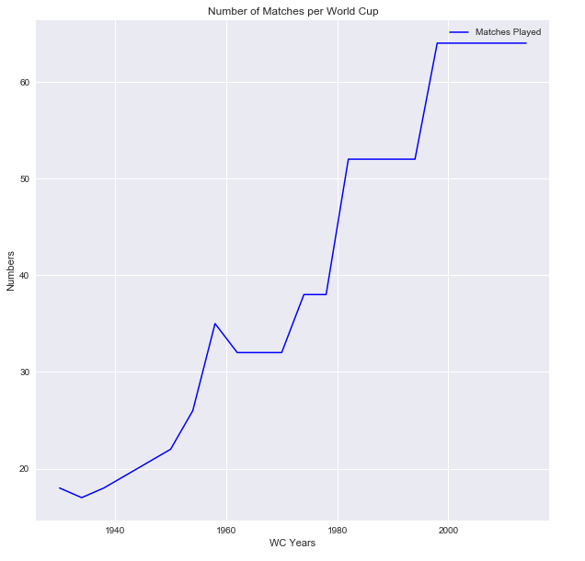
Number of Matches Per Year

Slide 23
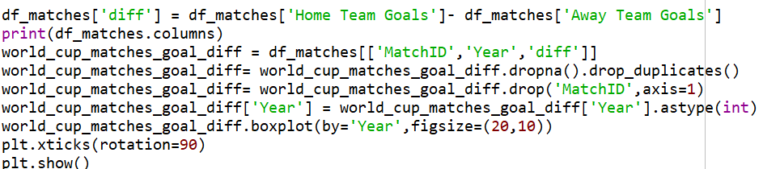
How does the distribution of goal differences over the championships change?

Slide 24
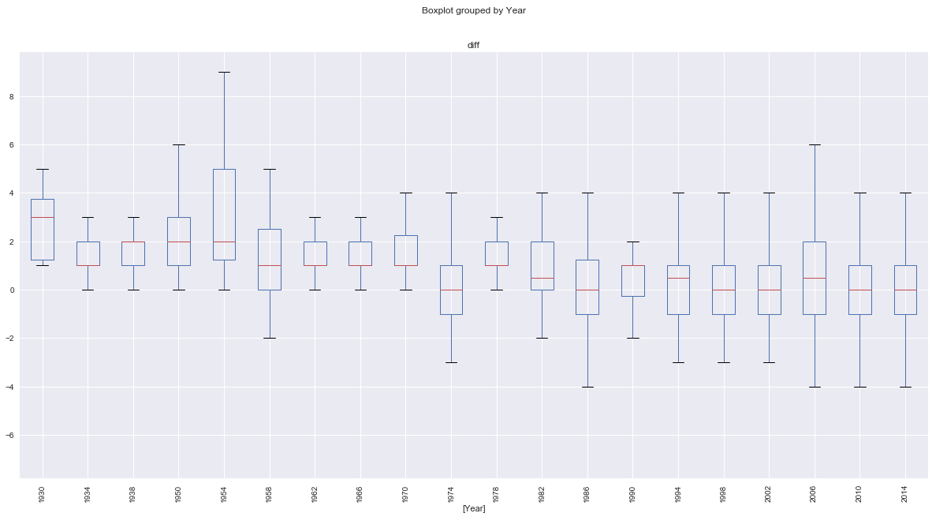

Slide 25
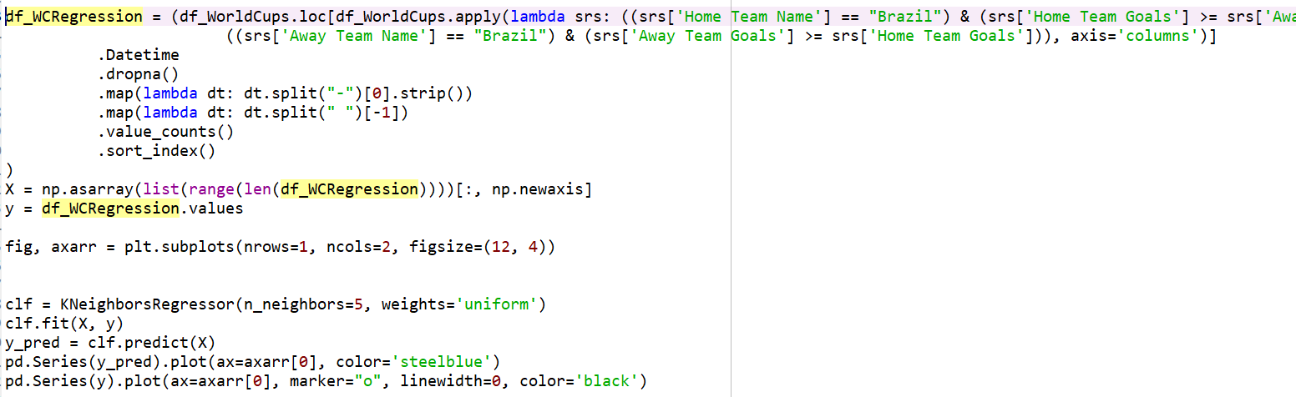
Who is likely to win the next world cup

Slide 26
Challenges
Data Sets found are redundant
Applying Machine Learning Algorithms and division of data into training and test data to obtain accuracy

Slide 27
Future Work
More Classification can be done for plotting the results.
The training data can be increased with more analysis with the existing data for obtaining the best results
Applying better Machine Learning Algorithms to Predict the results

Slide 28
Thank You..!!

